Slide 1


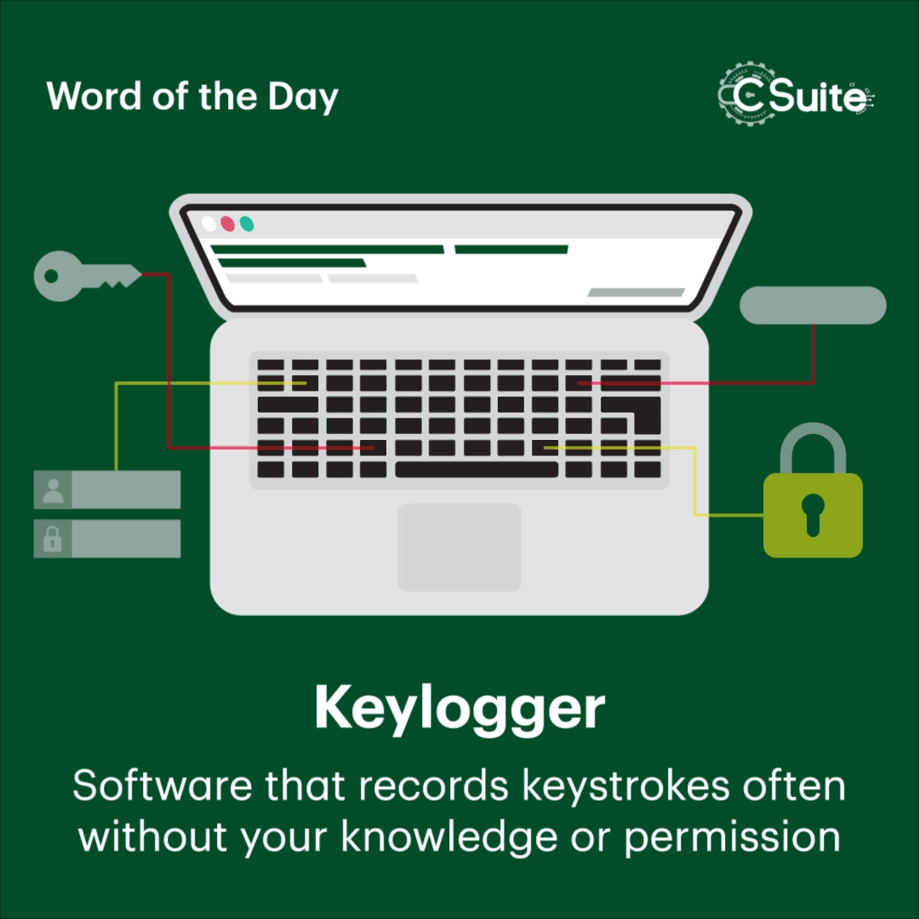
Ch.EswarKousik
-Final Project

Slide 2
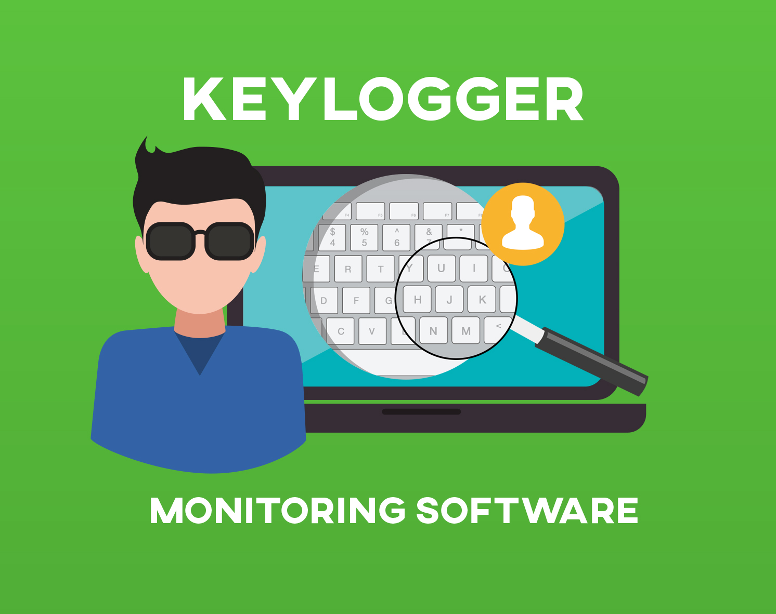
Keylogger
A keylogger is a type of software or hardware that records the keystrokes on a computer or device. It can capture everything you type, including passwords, messages, and other sensitive information.
Keyloggers are sometimes used for legitimate purposes like monitoring children’s online activities or employee productivity.
KeyLogger

Slide 3

Agenda
An introduction highlighting the importance of keyloggers, followed by a detailed exploration of project objectives, technical intricacies of key press capture, and the functionality of logging keystrokes to both text and JSON files.
The agenda includes a demonstration of the GUI interface, a discussion on ethical considerations surrounding keyloggers, and a live showcase of the keylogger in operation.
Keylogger

Slide 4
Problem Statement
Develop a sophisticated keylogger using Python, integrating the `pynput` library for key press monitoring and a user-friendly GUI designed with `tkinter`. The key objective is to create a secure and efficient keylogging tool that can accurately record and store keystrokes in various file formats. This endeavor seeks to address the need for a reliable keylogging solution that balances technical complexity with user accessibility, ensuring data integrity and ethical usage in the realm of cybersecurity and software development.
Key Logger

Slide 5
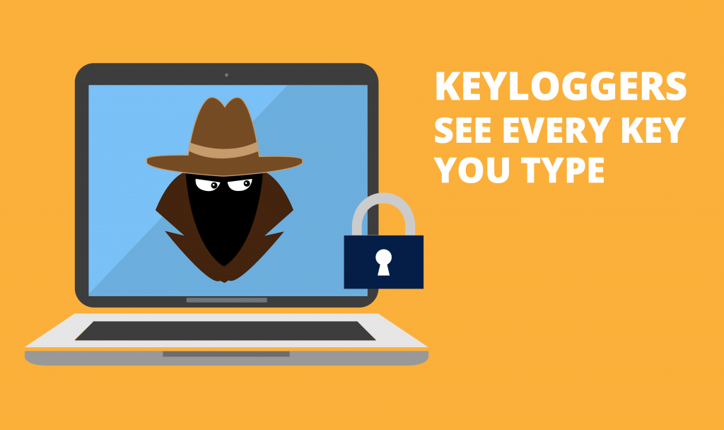

PROJECT OVERVIEW
Imagine delving into the realm of cybersecurity by crafting a cutting-edge Python keylogger enriched with a sleek graphical interface using `tkinter`. This project embarks on a journey to blend the art of key press monitoring with the science of user-friendly design, culminating in a dynamic tool that captures keystrokes with precision and presents them in a visually engaging format.
By harmonizing technical prowess with aesthetic appeal, this endeavor not only enhances data logging efficiency but also elevates the user experience, offering a novel perspective on the intersection of functionality and style in software development
MALWARE

Slide 6
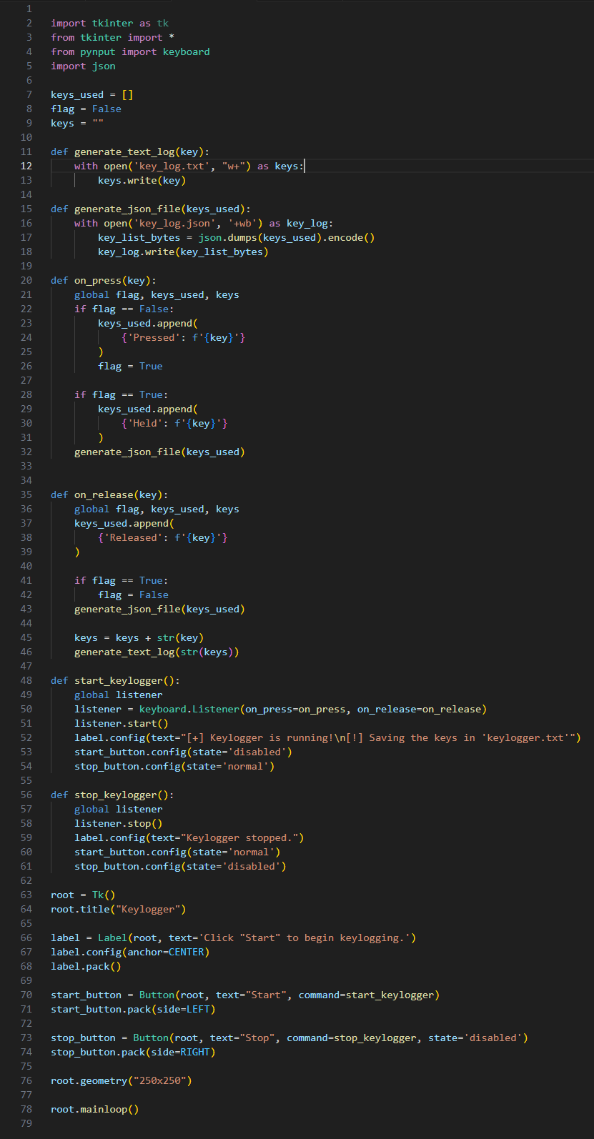
Who Are The End Users
The end users of this project could include cybersecurity professionals, software developers, ethical hackers, and individuals seeking to monitor and log keystrokes for security or productivity purposes.
Additionally, students or researchers interested in cybersecurity concepts and Python programming may also find this project beneficial for learning and experimentation. The user-friendly GUI aspect could attract individuals who prefer a visually appealing and intuitive interface for interacting with the keylogging tool.
MALWARE

Slide 7

Solution
Developing a solution for keylogger using pyinput and jsonlib
KeyLogger

Slide 8

The Wow In Solution
The wow factor in Python keylogger project solution lies in the seamless integration of advanced keylogging functionality with a visually appealing GUI interface. By combining the technical sophistication of key press monitoring with the user-friendly design of `tkinter`, not only excels in data capture accuracy but also enhances the overall user experience.
This harmonious blend of powerful functionality and elegant presentation sets your keylogger solution apart, offering a compelling and innovative approach to keystroke logging in the realm of cybersecurity and software development.
Key Logger

Slide 9
Modules
Keylogger Module : This module will handle the keylogging functionality using the `pynput` library to monitor and record keystrokes.
01
GUI Module : The GUI module will be responsible for creating the graphical user interface using `tkinter` to provide a visually appealing way for users to interact with the keylogger.
02
03
Pynput : `pynput` is a Python library that enables you to control and monitor input devices such as the mouse and keyboard
jsonlib : The standard library for working with JSON data in Python is called `json`. It provides functions for encoding Python objects into JSON strings and decoding JSON strings into Python objects.
04
Key Logger

Slide 10
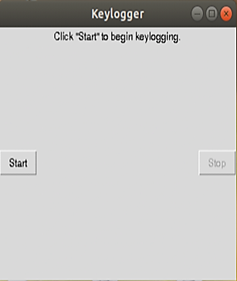
Results
Coupled with a sophisticated GUI, harmonizes advanced keylogging functionalities with an appealing user interface. This integration seamlessly captures keystrokes while presenting a visually engaging user experience.

Slide 11

Conclusion
Keylogger , enriched with a sleek GUI, epitomizes the synergy of cutting-edge keystroke capture and visually captivating user interaction. This fusion of advanced functionality and elegant design culminates in a distinctive and compelling tool for keystroke monitoring and recording.
The seamless integration of powerful features and aesthetic appeal sets your keylogger project apart, offering a sophisticated and innovative solution for user engagement and data monitoring

Slide 12
Project Link
Link : https://github.com/eswar1207/KeyLogger.git
Thank You!

